Slide 1
IRREGULAR VERB: Freeze/froze/frozen
Nositelj: Dr. sc. Moira Kostić-Bobanović

Slide 2
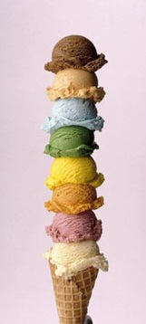
Verb
To become hard, and often turn to ice, as a result of extreme cold
Water freezes at 0°C.
To stop moving suddenly because of fear
I froze with terror as the door slowly opened.

Slide 3
Noun
(COLD WEATHER)
An unusual cold period of weather during which temperatures stay below 0°C.
Farmers still talk about the big freeze of ‘99.
(STOPPING STH)
An act of stopping something
A freeze on imports
(WAGES/PRICES)
The act of keeping wages, prices etc. at a particular level for a period of time
A wage/price freeze

Slide 4
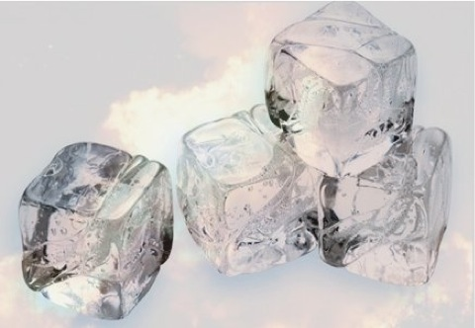
Synonym
Frost
Antonym
Thaw, melt

Slide 5
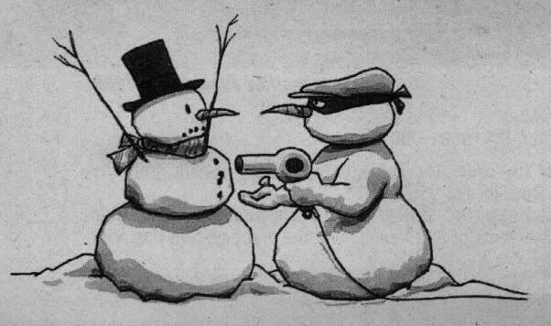
Conjugation of (to) freeze
BASE FORM | PAST SIMPLE | PAST PARTICIPLE | 3RD PERSON SINGULAR | PRESENT PARTICIPLE/ GERUND
Freeze | Froze | Frozen | Freezes | Freezing

Slide 6
Freeze UP
To stop moving or functioning because of extreme cold
All the locks had frozen up.
To be unable to think of anything to say, especially because you are nervous
He froze up during his presentation.

Slide 7
Freeze OUT
To be deliberately unfriendly to somebody, creating difficulties, etc. in order to stop or discourage them from doing something or taking part in something
We froze him out of our lives.

Slide 8
Freeze OVER
To become completely covered by ice
The lake freezes over in winter.

Slide 9
Insert the correct form of the verb to freeze.
The man stuck his tongue out on the signpost and his tongue _____ to the pole and got stuck. He couldn't move and the next morning, the man was found ______.
I can’t believe they _____ me _____ of their lives.
The child’s mittens ___________ stiff by the time the snowball fight ended.
All the locks had ________.
In Siberia, it can get so cold that the moisture in a person’s breath ______.
I’ll start writing your homework when Hell ___________.
”______” shouted the police officer.
Salaries ______________ for the current year.
It ___________ cold outside.

Slide 10
Insert the correct form of the verb to freeze.
The man stuck his tongue out on the signpost and his tongue _____ to the pole and got stuck. He couldn't move and the next morning, the man was found ______.
I can’t believe they _____ me _____ of their lives.
The child’s mittens ___________ stiff by the time the snowball fight ended.
All the locks had ________.
In Siberia, it can get so cold that the moisture in a person’s breath ______.
I’ll start writing your homework when Hell ___________.
”______” shouted the police officer.
Salaries ______________ for the current year.
It ___________ cold outside.
FROZE
FROZEN
FROZE
OUT
WERE FROZEN
FROZEN UP
FREEZES
FREEZES OVER
FREEZE!
HAVE BEEN FROZEN
‘S/IS FREEZING

Slide 11
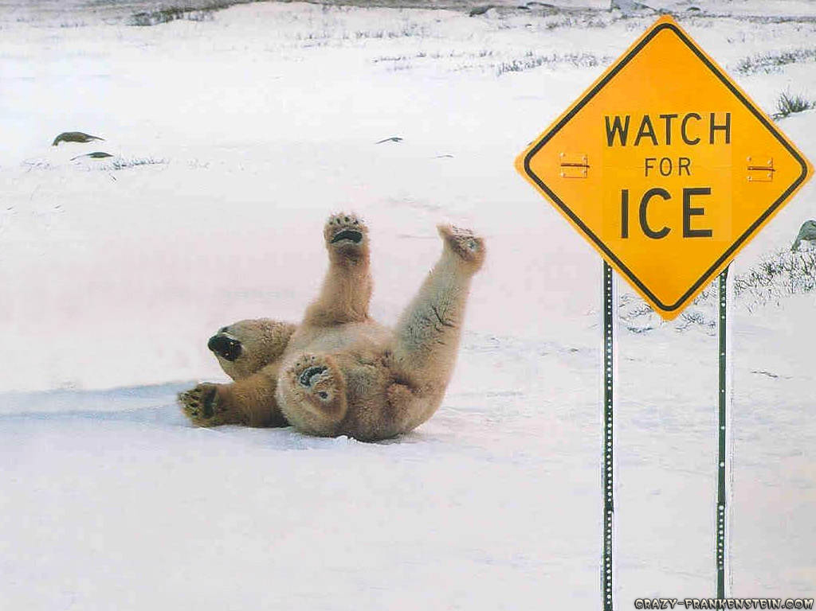
THANK YOU!!

